Slide 1

Student Management System
1ST YEAR STUDENTS SUMMER TRAINING

Slide 2
TEAM MEMBERS
Michael Mansour
Kareem Shaban
Mohamed Ashraf
Kerollos Edwar
Mohamed Abo Elyazed
Mohamed Asaad

Slide 3
ABSTRACT
The main objective of the is to manage the details of Profiles, Logins, student, courses, exams. it manages all the information about profiles, fees, exams, profiles. The project is totally built at administrative end and thus only the administrator is guaranteed the access

Slide 4
OUTLINE
INTRODUCTION
PURPOSE
FORMS DESIGN

Slide 5
INTRODUCTION
This project talks about student management system which provides staff the ability to write down all information about any student joined to the faculty and save it in file on the computer to revise it again at any time In this program the staff can add or remove or update information for any want when they want and they can add grades of subjects for each student

Slide 6
PUSRPOSE
The purpose of the project is to build an application program to reduce the manual work for managing the profiles, logins, fees, student. It tracks all the details about the student, courses, exams.

Slide 7
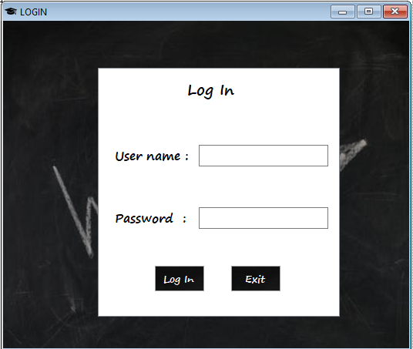
DESIGN

Slide 8
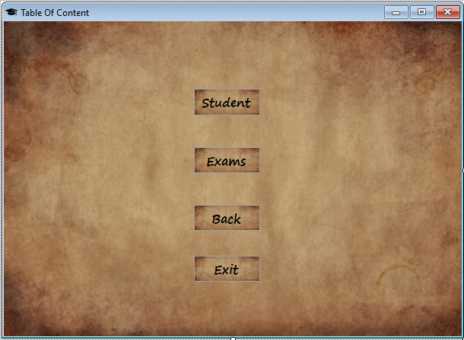
DESIGN

Slide 9
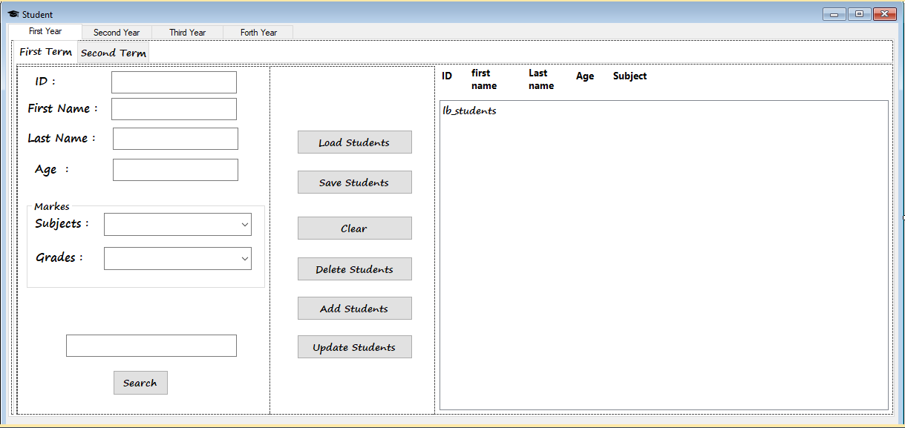
DESIGN

Slide 10
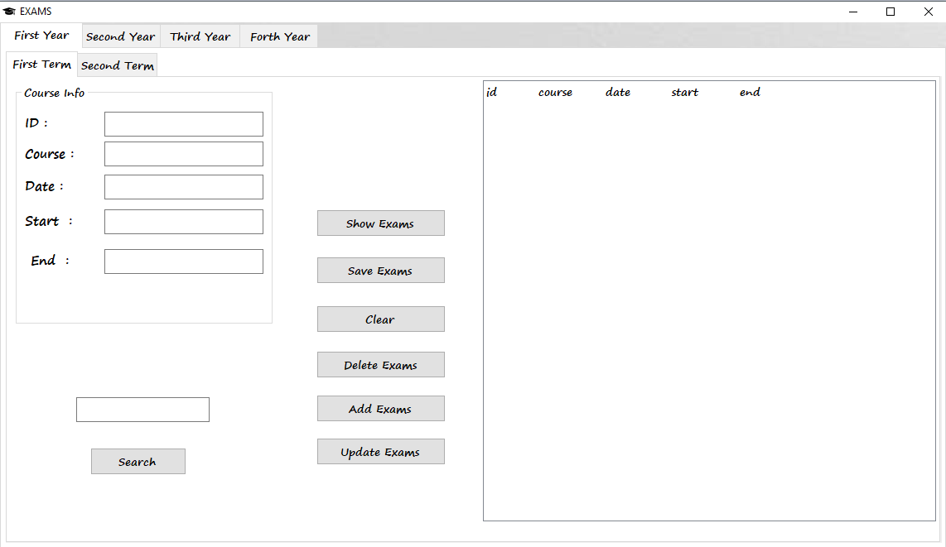
DESIGN

Slide 11
THANK YOU!

